Slide 1
How to take your social media marketing from
Good
Great
Awesome
West Virginia District Office
Notes:
Good morning, good morning! Thank you for joining SBA's West Virginia District Office for a session on how to take your social media from good to great to AWESOME! And before we get started I want to thank Nora Myers and the West Virginia Women's Business Center for having us today. My name is Nikki Bowmar and I'm the Public Affairs Specialists for SBA's WV District Office. Also today we have Kim Donahue our Branch Manager in Charleston that has a great love for Marketing....and we also have Raychel Fitzwater who came on board recently to help us with our COVID efforts, luckily Raychel has a background in Marketing and ready to give you some ideas today on how to take your social media from good to great to awesome.
We know COVID19 has really wrecked havoc on the small business community. And now with Small Business Saturday and the holiday season coming up,we want to help you get your social beefed up ready to go!
I have attended more trainings than I can count on social media, and at the end I always felt like I didn't know how to take what I learned and implement it for what I am doing. This training is different. We are going to show you some examples of good social media and then how you can make it better. At the end you'll have the opportunity for us to help show you how you can take your posts from good to great or awesome.

Slide 2
Email Updates
www.sba.gov/updates
Notes:
We would like to keep in touch with you. So please go to sba.gov/updates and sign up to receive the most up to date information from our district office, including any future training opportunities we may have.

Slide 3
Contact Information
View Upcoming Trainings
www.sba.gov/wv
SBA Office
www.sba.gov/wv
wvinfo@sba.gov
Notes:
You can find more information about us at sba.gov/wv and you can email us at wvinfo@sba.gov.
If you enjoy the training today and would like to attend other trainings we have available you can find the list at www.sba.gov/wv.

Slide 4
5 ways to go from Good, to Great, to Awesome!
1. Get creative.
2. Be relevant.
3. Take your store to your customer this year.
4. Contests.
5. Think outside the box!
Good
Great
Awesome
Notes:
Now, let's get started. We are going to give you 5 tips on how to go from good, to great, to awesome with your small business Saturday social media.
1. Raychel will give some ideas on getting creative.
2. I'll take about how you can be relevant in your marketing.
3. Raychel will show you how you can take your retail store to your customers this year because of COVID.
4. Kim will talk about contests.
5. And she'll also show you ideas of how to think outside the box.
Now, I'll turn it over to Raychel to talk about getting creative. Raychel, go ahead and unmute your line to begin.

Slide 5
Get Creative
Notes:
Thank you, Nikki! To get us started today, I’m going to go over some fun ways to be creative in engaging your customers or followers.

Slide 6
Give them something to talk about!
Wall mural
Include a hashtag
Wooden photo prop
Santa’s workshop
Community involvement
Local pep band playing holiday music
Notes:
One of the best ways to be creative…is to find something that your customers can talk about! Many people find it hard to draw in customers and find a way to get people in your business. Finding a way to get people talking about your business and what you are doing is key!
I’m going to give you a couple of examples of creative ways to engage with your customers. While its great to be creative you need to know how to get people engage so we are going to go over some examples that put the two together.
One great way to be creative is to actually be creative and commission a mural or some other kind of art in your business. If you can create an interactive piece that can be used as a place for your customers to take photos, you just found an easy way get free advertising and a recommendation by a customer. I will show you an example of this in a minute.
Similarly to creating a mural, a wooden photo prop is a creative way to get social media interaction. Using props that feature events that are happening around you, such a holidays, can help draw in customers.
And lastly another way to be creative is to find a way to draw in your local community. You can do this in several ways, like taking part events happening locally or hosting events that will draw people in
Now, let’s go over some examples on ways to be creative.
Next Slide.

Slide 7
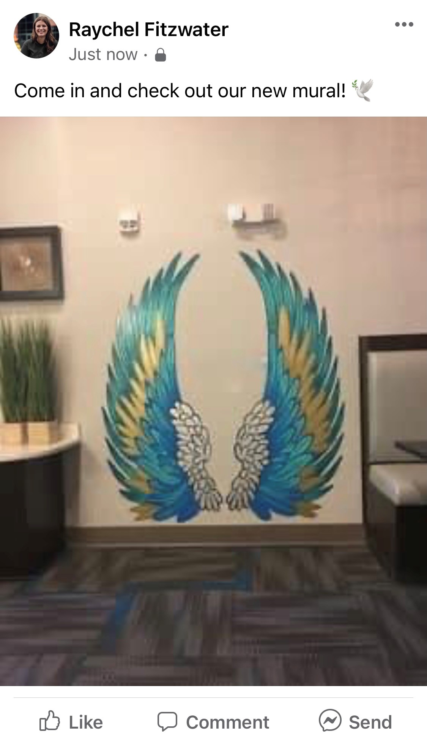
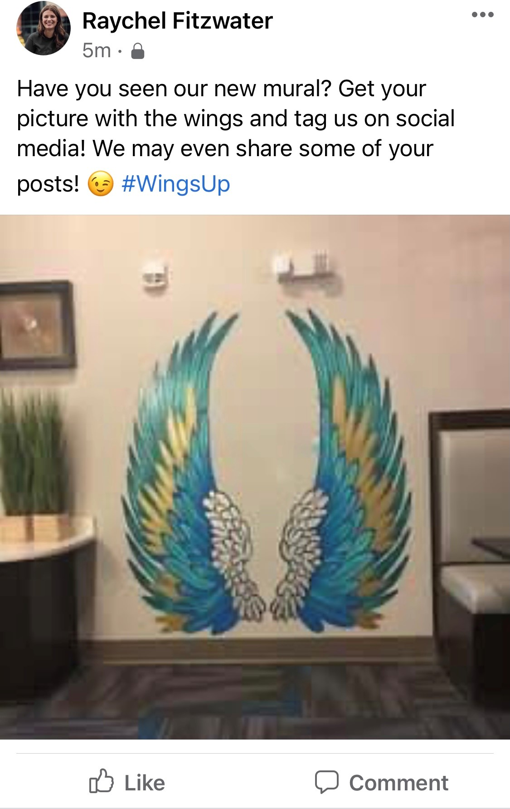
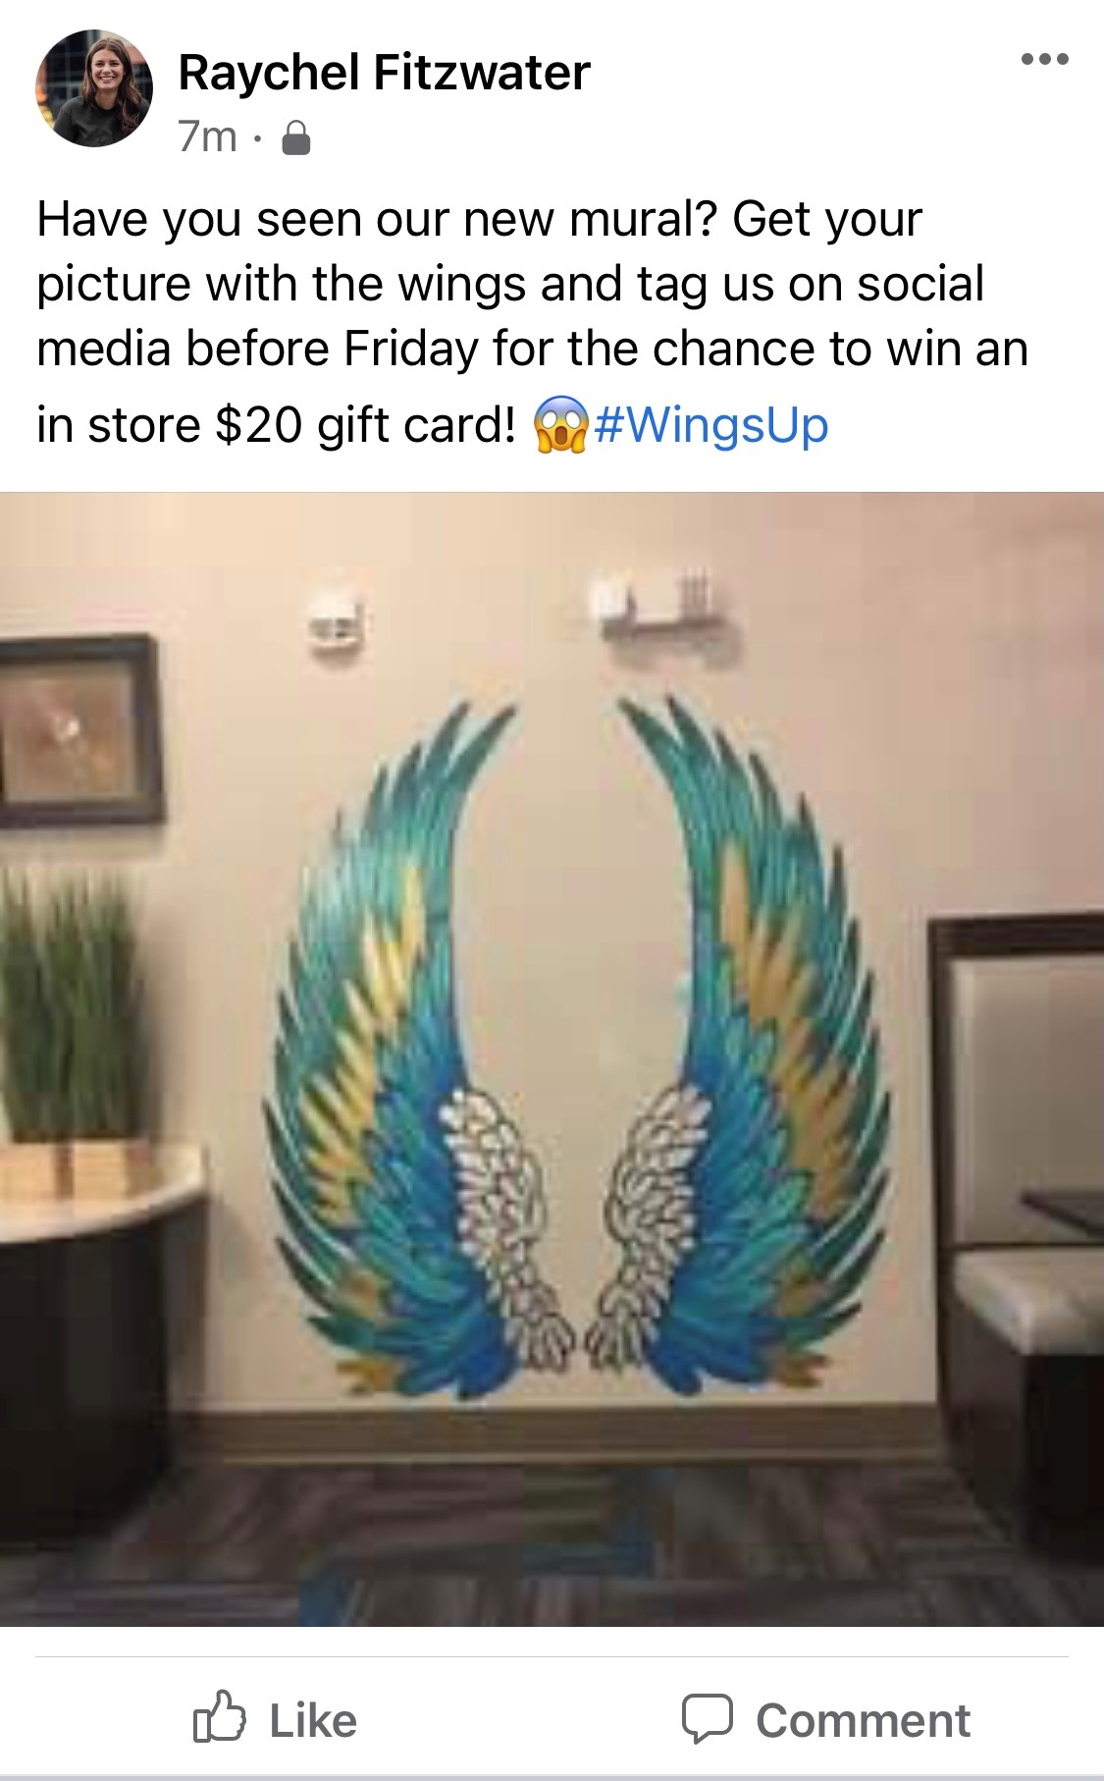
Murals
Find a way to get people posting about you.
Good
Great
Awesome
Notes:
Here is an example of a way to create a mural and get it talked about. While it may seem daunting to take on the task of creating a mural, an easy way to do this could be to use people from your community who could do it for free or at low cost. An example of this could be using an art student from a high school in your area or from a college near you. Once created, this is a great way to increase awareness of your store through one small feature.
Lets go over some ways to encourage people to post pictures with your mural and tag your store.
- Good: Come in and check out your new mural. While this is an okay post, I feel like we can make it better.
- Let’s try a great post: Have you seen our new mural? Get out picture with the wings and tag us on social media! We may even share some of your posts to our page.
Now let’s see what an awesome post could look like: Have your seen our new mural? Get your picture with the wings and tag us on social media before Friday for the change to win an instore $20 gift card.
Do you see how easy it is to go from good to awesome? Using incentives that are small costs can seem daunting but can be worth it in the long run because the increased social engagement can lead to an increase in customers over time.

Slide 8
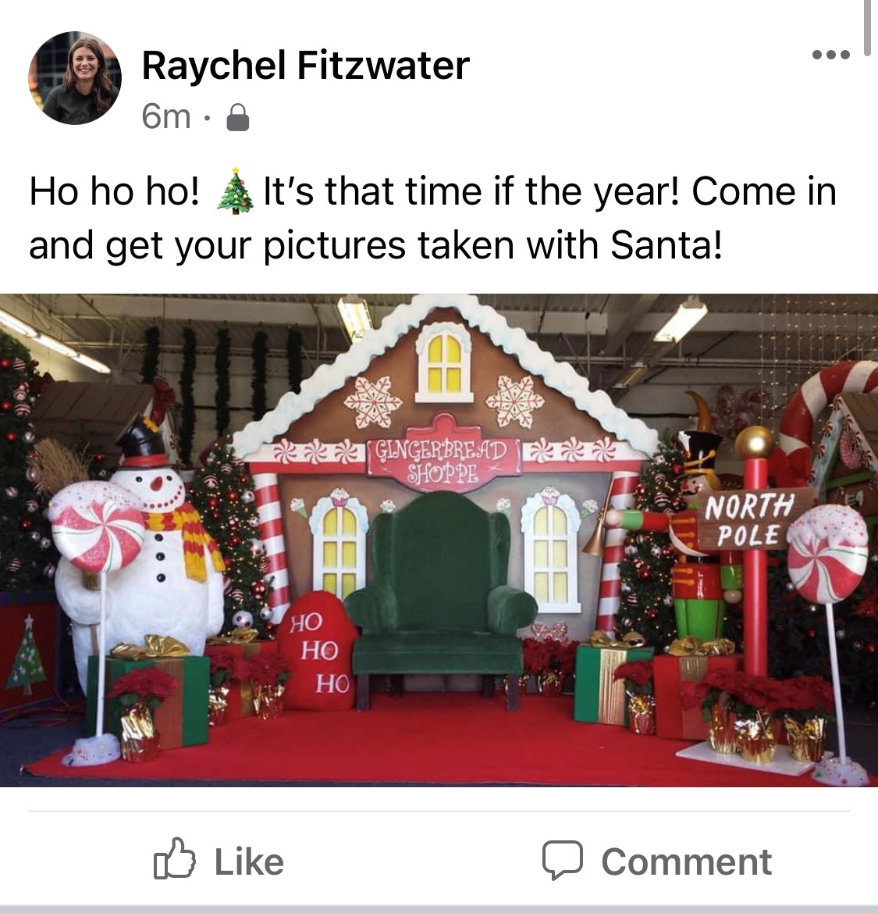
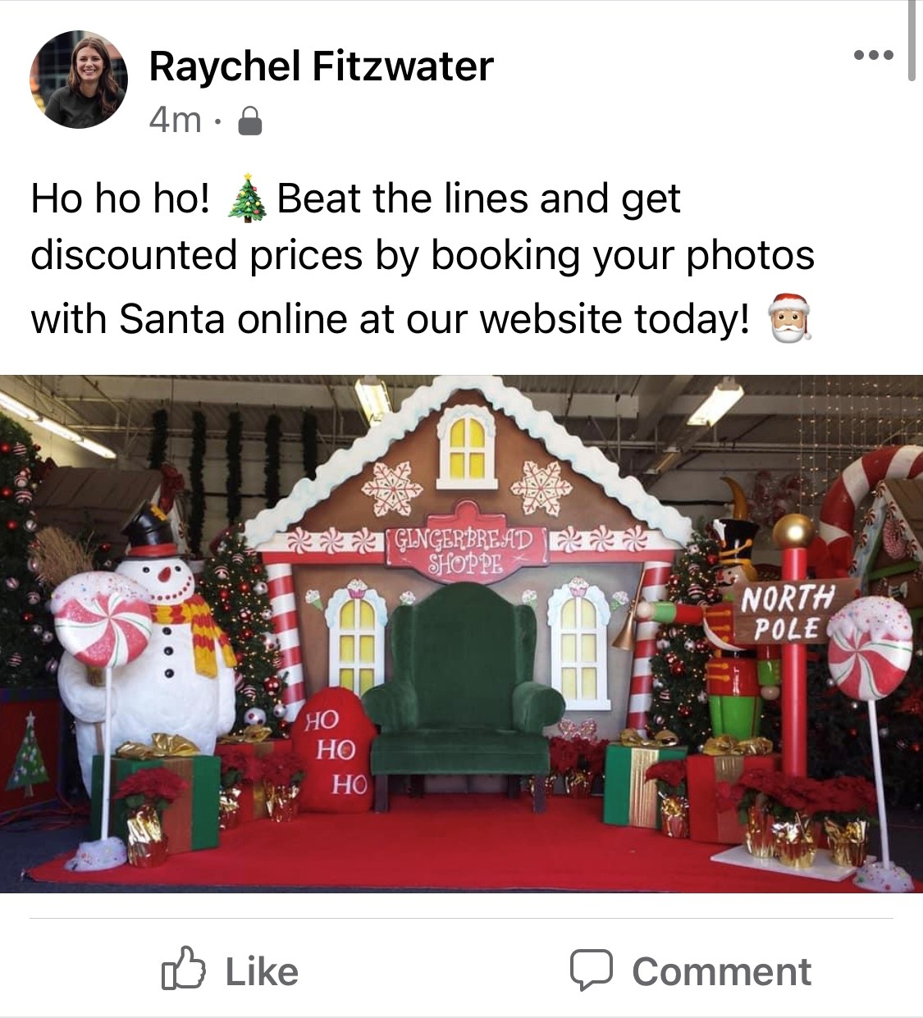
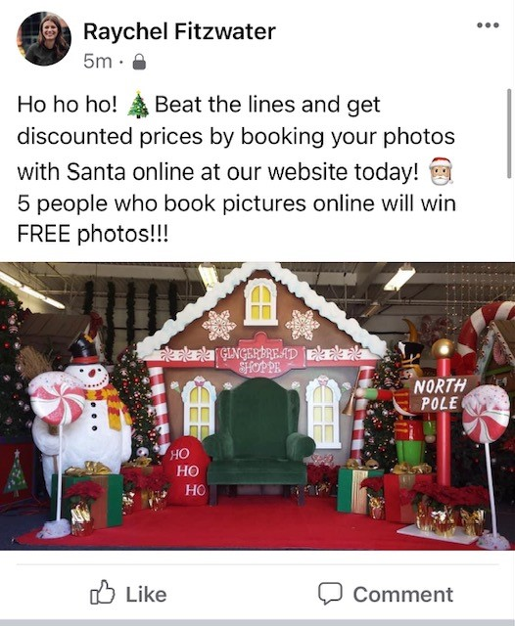
Wooden Photo Prop
Find a way to draw people to you either in person or online!
Good
Great
Awesome
Notes:
Let's look at the idea of using a wooden prop. Celebrating holidays or having your own special prop to take pictures with can draw in people who may not regularly come to your store. Get customers to your website and in stores by creating something to get people talking about you.
For this, a good post could be something like: Ho ho ho, its that time of the year! Come in and get your picture taken with Santa.
A great post could be: Ho ho ho, beat the lines and get discounted prices by booking your photos with Santa online at our website today.
And for an awesome post, just adding one line can really make a difference in increasing foot traffic on your website: Ho ho ho, beat the lines and get discounted prices by booking your photos with Santa online at our website today. 5 people who book online will win free photos!

Slide 9
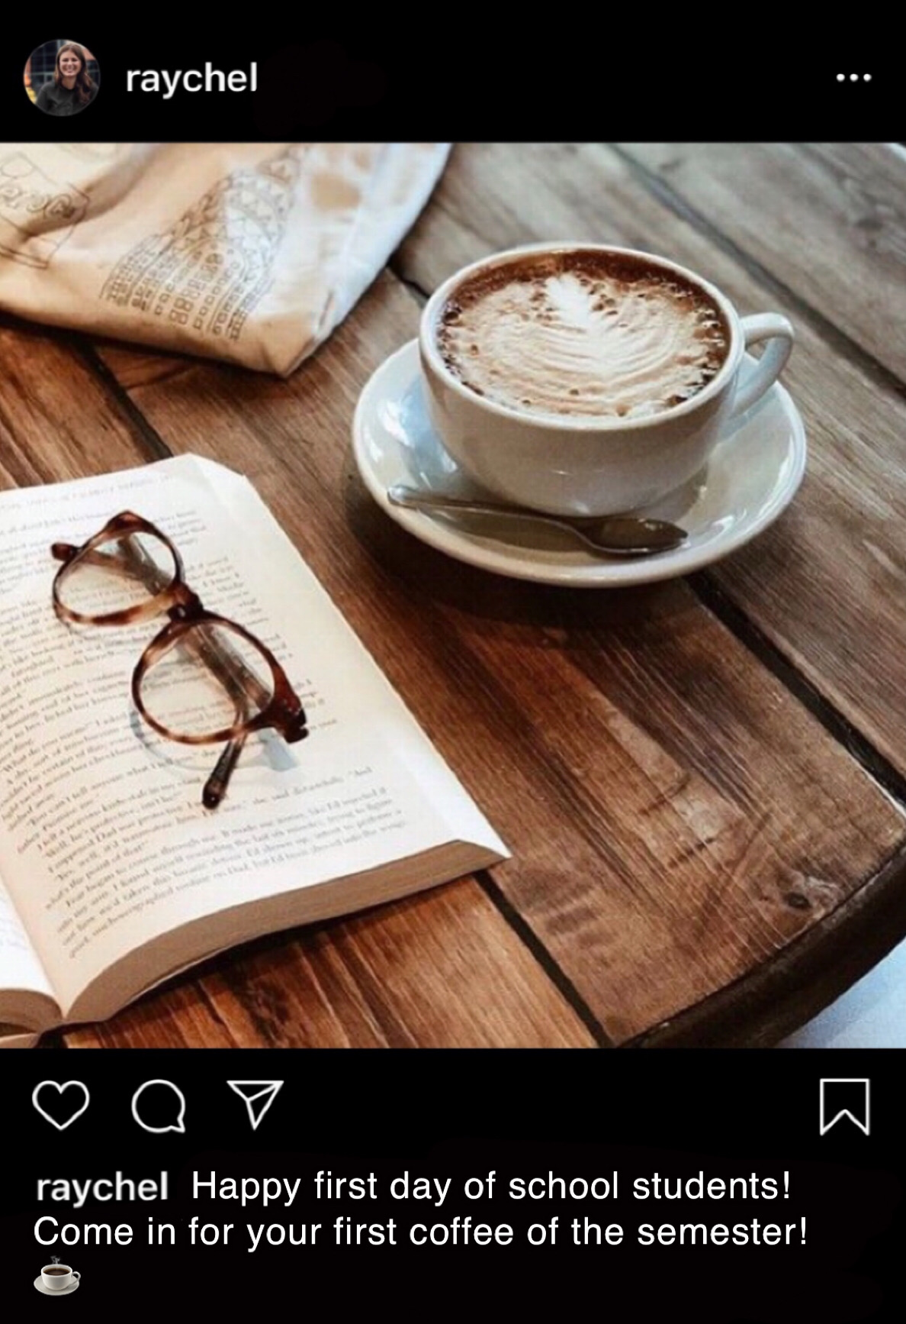
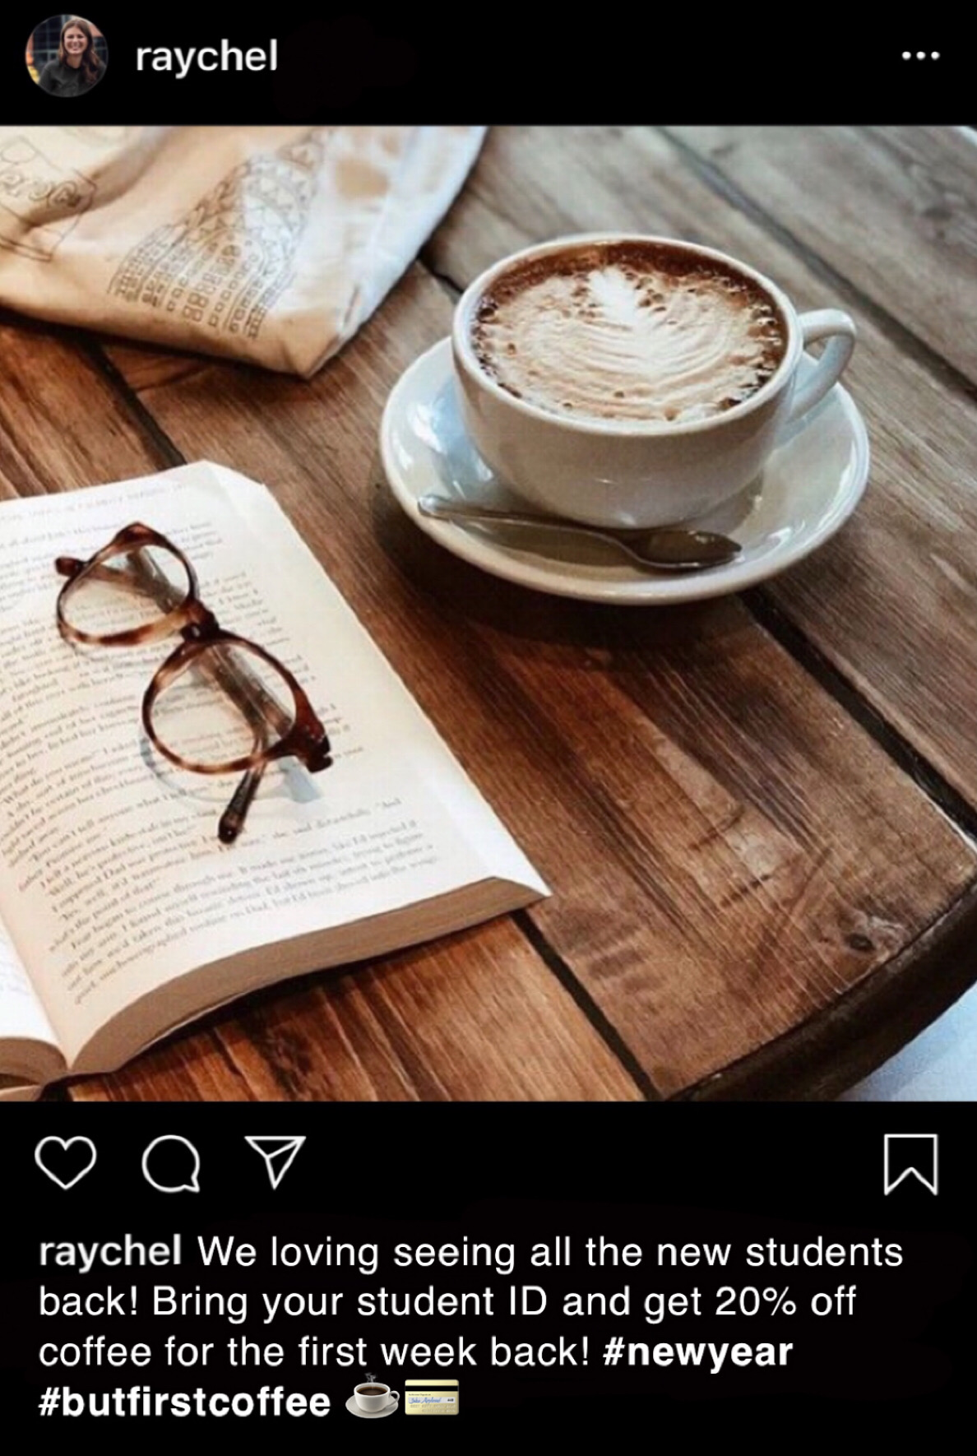
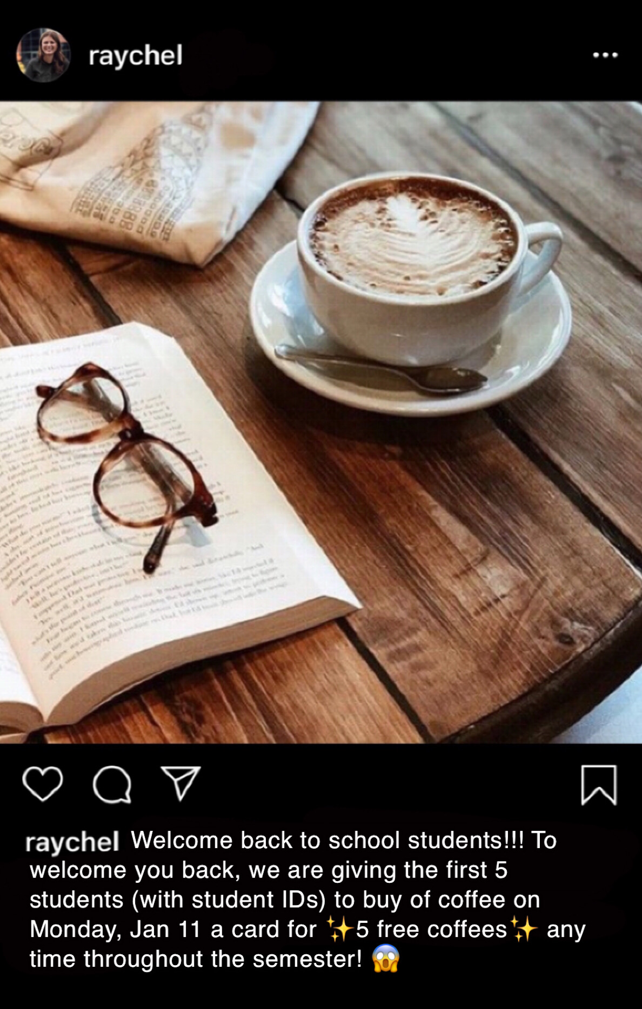
Involve the Community
Find ways to draw new customers in
Good
Great
Awesome
Notes:
Find a way to connect with the community. If you are a college town, offer discounts to students if the have their student IDs. If band or sports is big in your area, finding a way to get those large groups into your business.
Here is an example of how to do that from good to awesome by drawing in college students.
Good: Happy first day of school students? Come in for your first cup of coffee of the semester!
Great: We loving seeing all the new students back! Bring in your student ID and get 20% off coffee for the first day!
Awesome: Welcome back to school students!! To welcome you back, we are giving the first 5 students (with student IDs) to buy coffee come Monday, Jan 11 a card for 5 free cups of coffee any time throughout the semester!

Slide 10
Be relevant
Notes:
Now we are going to talk about something that sounds soooo simple but many miss the mark when it comes to marketing.
One of the best ways to engage your customers is to be relevant.
I told you...sounds simple, right?
But are you taking full advantage of this?
Next slide.

Slide 11
Use the news to drive your marketing!
National News
Local & Community Events
"National Day of the Week"
Cause Marketing
Notes:
I want to give you just a few examples of how to build your social media content around current news that is relevant. If we have an social media coordinators or directors on here you know how difficult it can be to find enough content to post multiple times a day. So why not use what is going on in the news?
- One way to do that is to talk about what is happening nationally? So we just wrapped up election day but that is a great example we'll walk through how you can do that without being political.
- Another way to be relevant with your social media content is to talk about local and community events. Here in Bridgeport we have big sports rivals and annual community events, that is a great way to add relevant content to your social media calendar.
- "National Day of the Week" calendar is a really good way to have fun, be interactive with your followers, and be relevant.
- And lastly, tying in cause marketing.
Now let me show you some examples.
Next Slide.

Slide 12
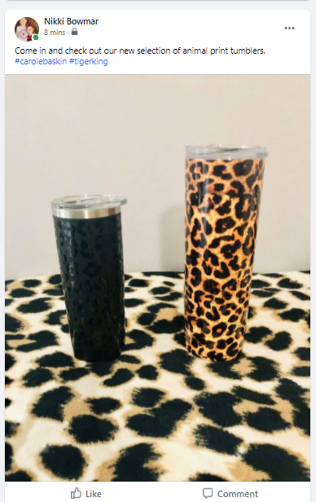
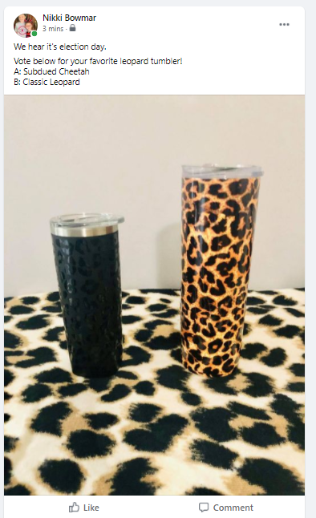
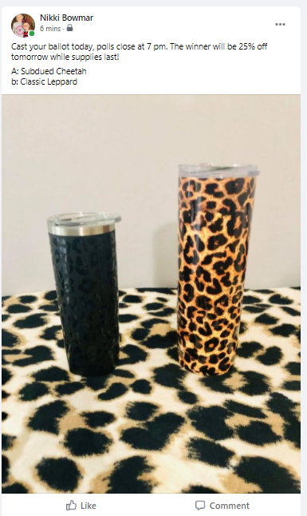
National News
What is going on in national news that you can tie to?
Good
Great
Awesome
Notes:
Here is an example of how to take national news...like election day. I have a ton of drink tumblers....so all my examples will be about tumblers.
First you see an example of a good social media post: Come in and check our our new slection of animal print tumbers.
Second, you see how to make that same picture/idea great: We hear it's election day. Vote for your favorite tumber below.
Now....let's make it awesome: Cast your vote today for your favorite tumbler and tomorrow the winner wil be 25% off while supplies last.
I hope this gives you an idea of how to translate good, great, awesome to your social media marketing.
Next slide.

Slide 13
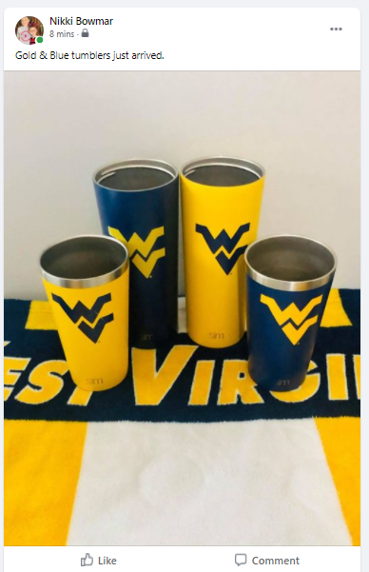
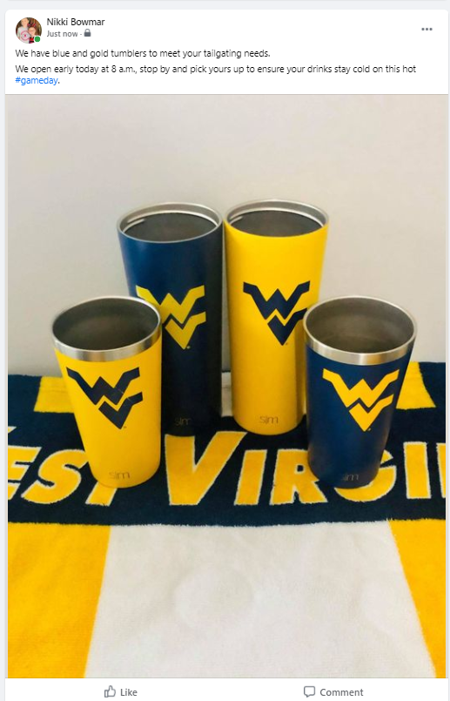
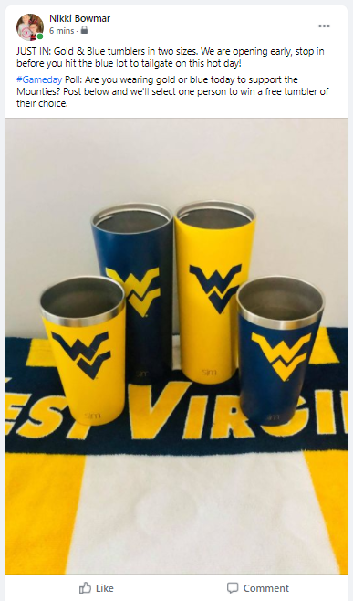
Local News
What is going on in local news that you can connect with?
Good
Great
Awesome
Notes:
Now, let's talk about local news. If you are in WV you either bleed gold and blue or you are a Marshall fan.
So, a good way to push merchandise off your selfs is to tie it to sports.
A good post would be: Gold & Blue tumblers just arrived. It is visual, gets to the point, done. It's good.
A great post would be: We have blue and gold tumberls to meet your tailgating needs. We open early, stop by to pick yours up to keep your drinks cold on this hot day. With a relevant hashtag. That just went from good to great.
Now, let's make it awesome: Just In: Gold & Blue tumbelers in two sizes. We are are open early, stop in before you head out. And I added a poll: Are you wearing gold or blue to today. Post below and we'll select one person to win a free tumbler of their choice. Do you see how that one poll, adds interaction and takes your post from great to awesome?
Are you seeing how easy it is to slightly modify your post to make it more interative and awesome?
Next slide.

Slide 14
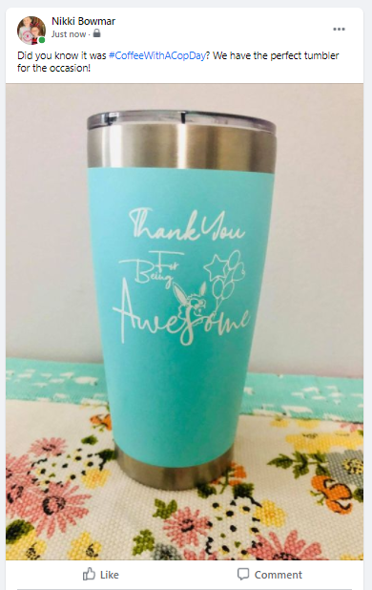
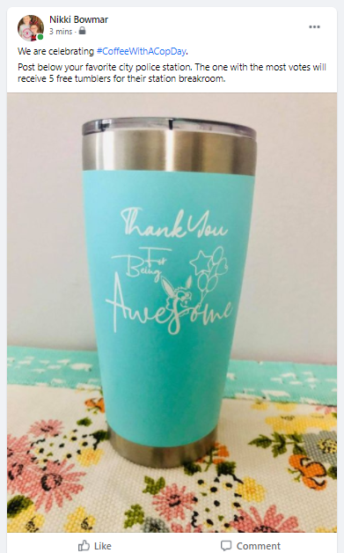
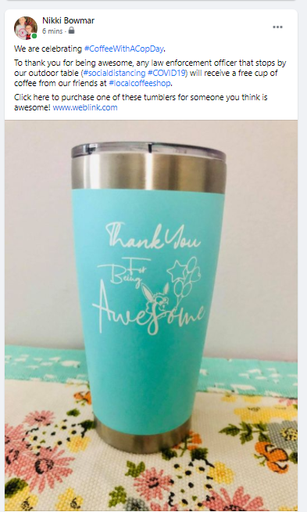
National Day
Tap into the "National Day of the Week" calendar.
Good
Great
Awesome
Notes:
Alright, another topic...another tumbler.
A great way to create content is to use National Days of the Week calendar.
Here are some examples on how to go from good, to great, to awesome.
- Good: Did you know it was national "Coffee with a cop day"? We have the perfect tumbler for the occasion.
- Great: We are celebrating "Coffee with a cop day". Post below your favorite city police station. The one with the most votes receives 5 free tumblers for their station breakroom.
- Now awesome: We are celebrating national "Coffee with a cop day" Thank you for being awesome (tieing in the picture), any law enforcement to stop by our outdoor table (taking into consideration social distancing) will receive a free cup of coffee from our friends at local coffee shop (another great way to be relevent...partner with other small businesses). Then add in information on how they can purchase this tumbler with the website.
Do you see how changing the tone of the post takes it from selling...to giving....to selling and awesome?
Next slide.

Slide 15
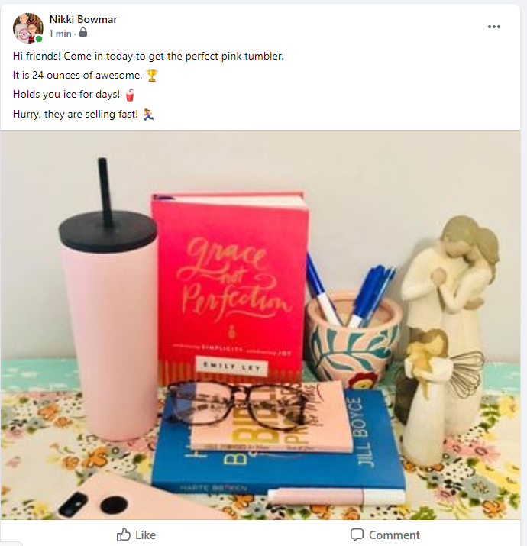
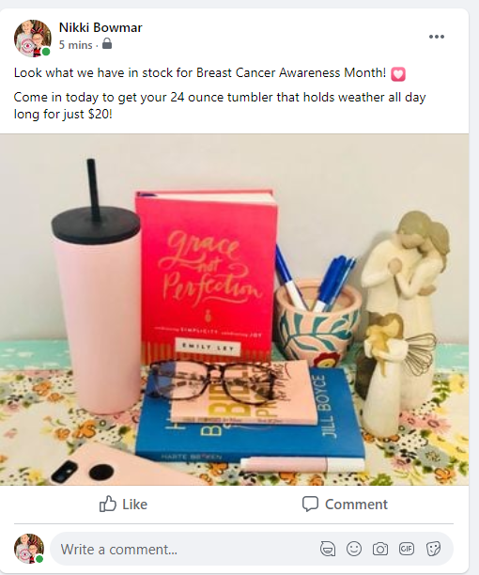
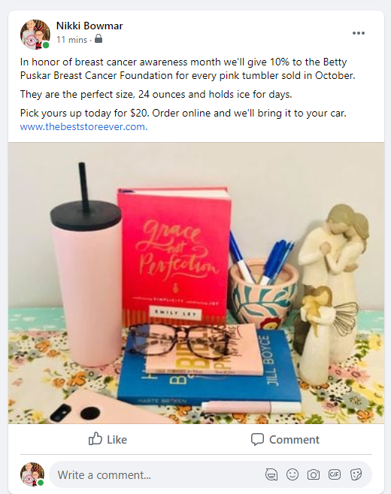
Give Back
Give Back Campaign is a great way to promote your merchandise while supporting a cause close to your heart.
Good
Great
Awesome
Notes:
The last thing I want to talk about is cause marketing and being relevant.
First I want to say, this is a great way to promote your merchendise and support a cause that is close to your heart. But make sure you are authentic. Pick what is important to you and use this sparingly.
Here is an example of a good post: Come in today to get the perfect pink tumbler, it's 24 ounces, holds ice for days. Hurry they are selling fast. Not a bad post, right.
Here is a way to make it great: Look what we have in stock for Breast Cancer Awareness Month. Come in today to get your 24 ounce pink tumbler that holds water (sorry, typo there) all day long for $20.
Now, let's make it awesome: In honor of breast cancer awareness month we'll give 10% to the Betty Puskar Breast Cancer Foundation for every pink tumbler sold in October. Also adding a web online store pick ups.
I hope this section showed you how you can be relevant....and take your content from good to great to awesome.

Slide 16
Take your store to your customer
Notes:
We are going to talk about one of the hardest things for a business right now… finding a way make sales and get customers interacting with you during this crazy time. One of the best ways to do that is to take your store to your customer.

Slide 17
Social Distancing to the Extreme
Have a tent sale, sidewalk sale, pop up outdoor market
Beef up your website
Use your social media to go live and have daily/weekly specials
Notes:
Some of your clients may still be hesitant to come inside your store. That means you need to find a way to take it to them. Finding ways for customers to shop while social distancing can be difficult for some business due to guidelines. We have some examples on ways you can social distance to the extreme.
A popular way to take your store to customers is though tent sales or sidewalk sales. Setting up a table with your items on it at an outdoor market or craft show. Setting up a display at a local event or even hosting your own event is a great way to take your store to people.
Online shopping has become more and more popular. If you don’t already have one, creating a reliable website for your customers to shop at is crucial. If you do have one, focus on “beefing it up”. Making sure that it’s up to date and
Using social media to do virtual shopping and product show casing has become more and more popular
Let’s look at an example of this on social media.

Slide 18
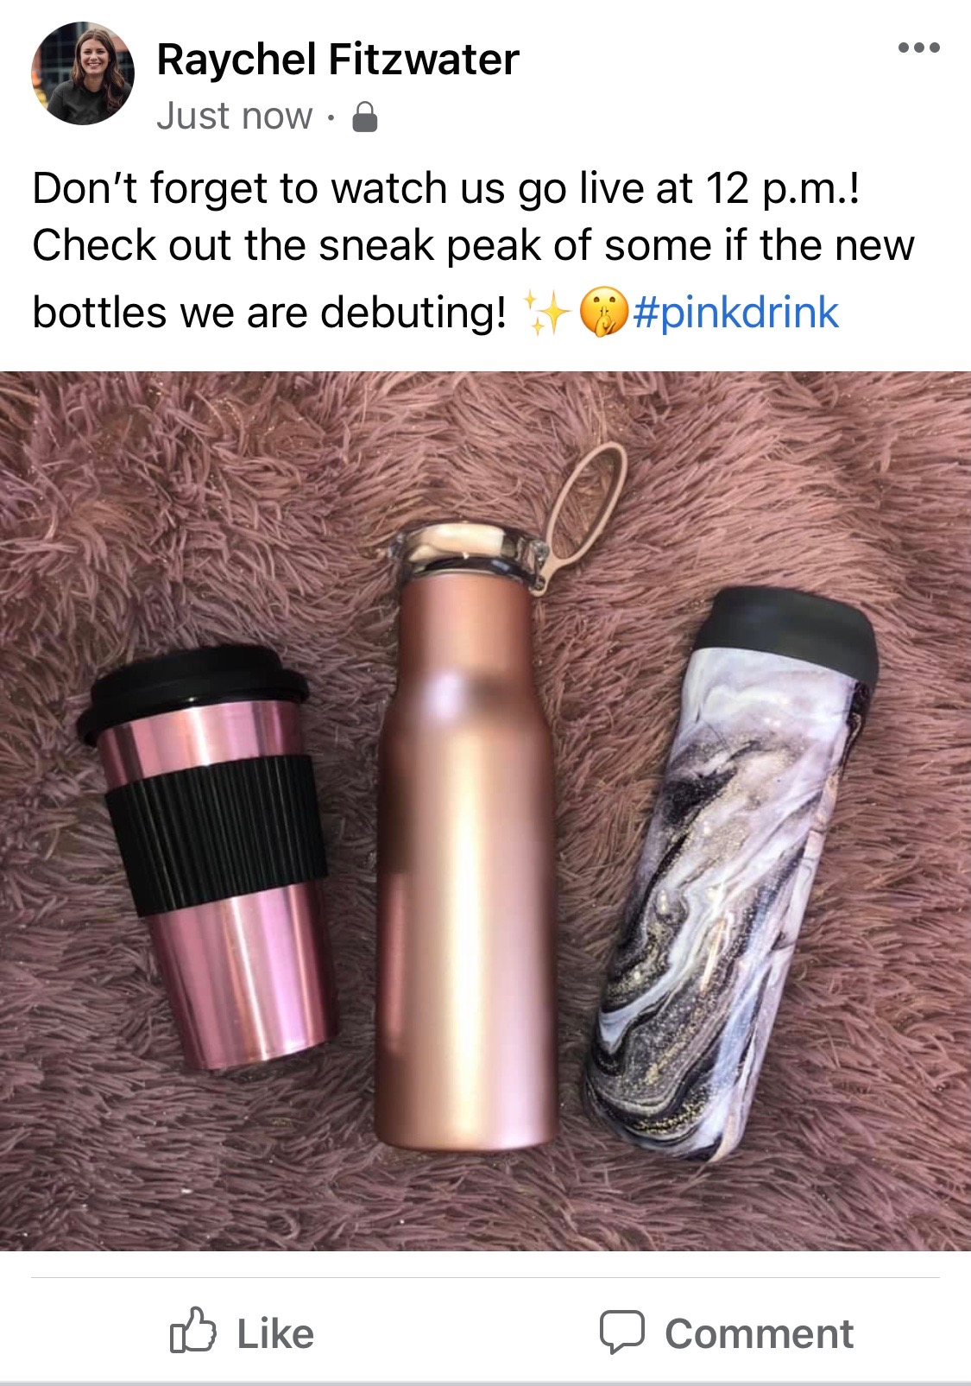
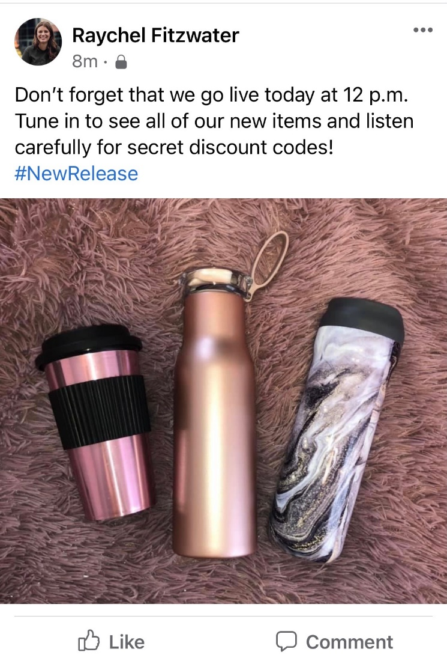
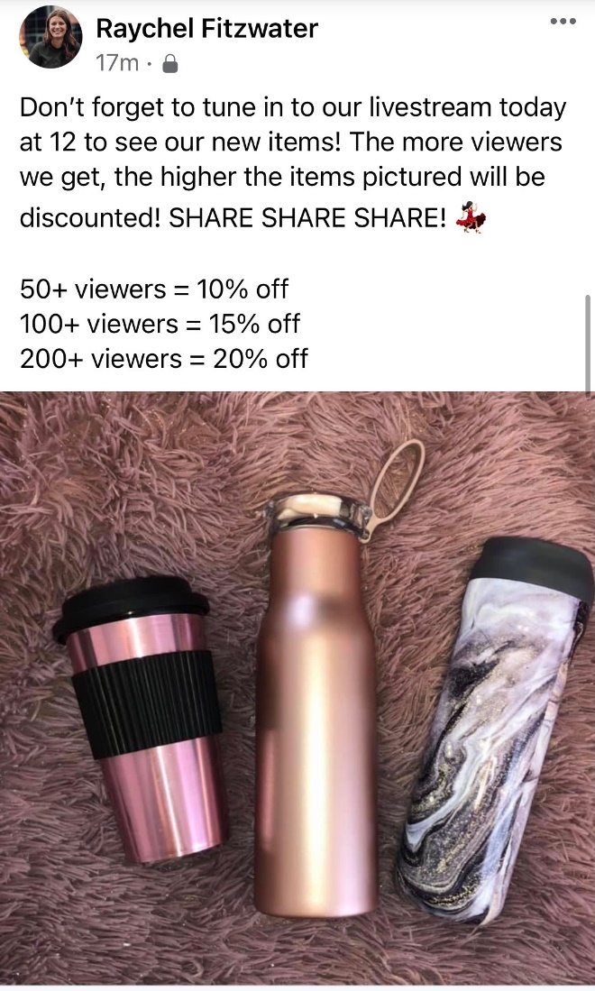
Livestreams
Live stream products to raise product awareness
Good
Great
Awesome
Notes:
Livestreams
Great way to showcase products to people
Use different platforms to meet your audience's preferences
Facebook
Instagram
Way to sell items virtually
Give special discounts codes or % off to draw customers in and sell certain items

Slide 19
Contests

Slide 20
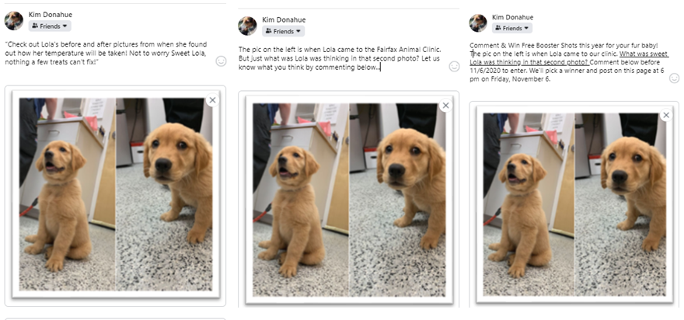
Name that Photo
Good
Great
Awesome
Notes:
The name of the game here is engagement. Post one is good and funny: "Check out Lola's before and after pictures from when she found out how her temperati=ure will be taken. Not to worry, Sweet Lola, nothing a few treats can't fix!" It's cute but there's no ask for engagement. Post #2 is better: The Pic on th eleft is when Lola came to the Animal Clinic. But just what was Lola thinking in photo number 2. Can you guess? Comment below." Okay, now we've written in the ask—input. #3 is " Comment and win free BoosterShots ;this year for your fur baby. The photo on the left is Lola's first fisit. The second? Lola got some disburbing news. What did Lola find out? Email your ideas to info@ACMEAnimalClinc.com before Friday, November 6 and we'll post your comments and the winner Friday at 6 pm!
I'll admit, it's hard to get people to leave FB for a web site or another app, but if you CAN get them to your domain, you also have a better opportunity to promote your business.

Slide 21
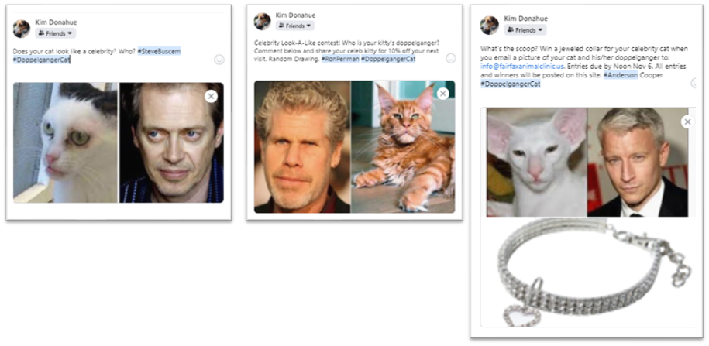
Look Alikes
Good
Great
Awesome
Notes:
Here's another option, playing on the Look Alike contest. Does your cat resemble a celebrity? And then I used a hashtag #doppelgangercat and #SteveBuscemi. Again, no engagement but cute. Post #2 is the same theme, but turns it into a contest-- "Celebrity Look-A-Like contest! Who is your kitty’s doppelganger? Comment below and share your celeb kitty for 10% off your next visit. Random Drawing. #RonPerlman #DoppelgangerCat." Now we've shared the rules and what to win. #3 just takes it up a notch-- What’s the scoop? Win a jeweled collar for your celebrity cat when you email a picture of your cat and his/her doppelganger to: info@ACMEanimalclinic.com on Nov 5. All entries and winners will be posted Nov 6 at 6. #Anderson Cooper #DoppelgangerCat." So we've got a couple of advantages here—it's a cheap but great looking reward. AND we're hashtagging our celebrities.

Slide 22
Think outside the box!

Slide 23
There are no boxes in marketing!
Could you be pet friendly?
Online Window Shopping?
Going Behind the Scenes
Notes:
If

Slide 24
Dog Friendly
Good
Great
Awesome

Slide 25
Online Window Shopping
Good
Great
Awesome

Slide 26
Show Behind the Scenes
Good
Great
Awesome

Slide 27
Now, let us help you go from
Good
Great
Awesome
Notes:
Okay, so I really hope that the these examples gave you ideas on how to take your small business saturday social media marketing from good, to great, and hopefully to awesome.
But....if you have questions or need ideas, now is the time to ask. Kim, Raychel and I are hear for you to bounce ideas off of. So feel free to use the comment section and we'll see if we can help you think of ideas.

